Slide 1
Lecture - 1
Chapter 3: Resistance
Abu Ahmed Ferdaus, CSE, DU.

Slide 2
This lecture includes:
Introduction
Resistance: Circular wires
Temperature Effect on the Resistance
Types of Resistors: Fixed and Variable
Color Coding and Standard Resistor Values
Conductance
Ohmmeter
Other Devices
Abu Ahmed Ferdaus, CSE, DU.

Slide 3

3.1 Introduction
The flow of charge through any material encounters an opposing force which is due to the collisions between electrons and between electrons and other atoms in the material, which converts electrical energy into another form of energy such as heat, is called the resistance of the material.
The unit of measurement of resistance is the ohm,Ω, the capital Greek letter omega.
The circuit symbol for resistance appears here with the graphic abbreviation for resistance (R).
Abu Ahmed Ferdaus, CSE, DU.

Slide 4
3.1 Introduction
The resistance of any material with a uniform cross-sectional area is determined by the following four factors:
1. Material
2. Length
3. Cross-sectional area
4. Temperature
The longer the path the charge must pass through, the higher the resistance level, whereas the larger the area (and therefore available room), the lower the resistance. Resistance is thus directly proportional to length and inversely proportional to area.
Abu Ahmed Ferdaus, CSE, DU.

Slide 5


3.1 Introduction
Conductors that permit a generous flow of charge with little external pressure will have low resistance levels, while insulators will have high resistance characteristics.
As the temperature of most conductors increases, the increased motion of the particles within the molecular structure makes it increasingly difficult for the “free” carriers to pass through, and resistance level increases.
At a fixed temperature of 20°C (room temperature), the resistance is related to the other three factors by
where ρ (Greek letter rho) is a characteristic of the
Abu Ahmed Ferdaus, CSE, DU.

Slide 6
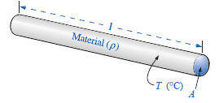
3.2 Resistance: Circular Wires
material called the resistivity, l is the length of the sample, and A is the cross-sectional area of the sample.
For a circular wire factors affecting the resistance of a conductor are defined by the following figure:
For two wires of the same physical size at the same temperature :
1. the higher the resistivity, the more the resistance.
2. the longer the length of a conductor, the more the resistance.
Abu Ahmed Ferdaus, CSE, DU.

Slide 7
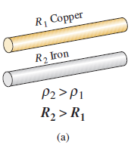
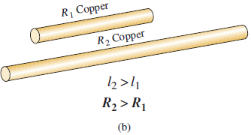
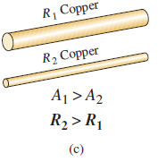
3.2 Resistance: Circular Wires
3. the greater the area of a conductor, the less the resistance.
4. the higher the temperature of a conductor, the more the resistance.
Abu Ahmed Ferdaus, CSE, DU.

Slide 8

3.2 Resistance: Circular Mils (CM)
The area is measured in a quantity called circular mils (CM).
The mil is a unit of measurement for length and is related to the inch by
By definition, a wire with a diameter of 1 mil has an area of 1 circular mil (CM)
Abu Ahmed Ferdaus, CSE, DU.

Slide 9
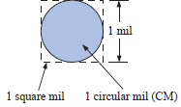

3.2 Resistance: Circular Mils (CM)
One square mil was superimposed on the 1-CM area clearly show that the square mil has a larger surface area than the circular mil.
Applying the above definition to a wire having a diameter of 1 mil, we have
Abu Ahmed Ferdaus, CSE, DU.

Slide 10



3.2 Resistance: Circular Mils (CM)
Therefore,
So, 1sq mil = 1.273 CM
For a wire with a diameter of N mils (where N can be any positive number),
So,
Abu Ahmed Ferdaus, CSE, DU.

Slide 11
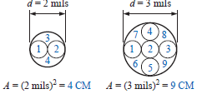
3.2 Resistance: Circular Mils (CM)
Since d = N, the area in circular mils is simply equal to the diameter in mils square; that is,
Verification that an area can simply be the diameter squared is provided in part for diameters of 2 and 3 mils. Although some areas are not circular, they have the same area as 1 circular mil.
Abu Ahmed Ferdaus, CSE, DU.

Slide 12

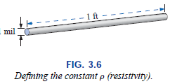
3.2 Resistance: Circular Mils (CM)
The constant ρ (resistivity) is different for every material. Its value is the resistance of a length of wire 1 ft by 1 mil in diameter, measured at 20°C.
Abu Ahmed Ferdaus, CSE, DU.

Slide 13
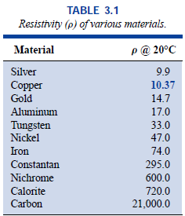
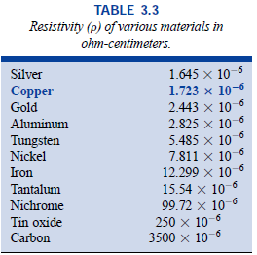
3.2 Resistance: Circular Mils (CM)
The resistivity ρ is also measured in ohms per mil-foot, or ohm-meters in the SI system of units. Some typical values of ρ are provided in the following tables:
Abu Ahmed Ferdaus, CSE, DU.

Slide 14
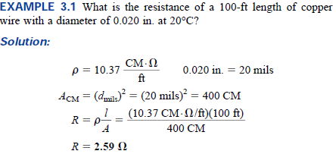
3.2 Example 3.1
Abu Ahmed Ferdaus, CSE, DU.

Slide 15
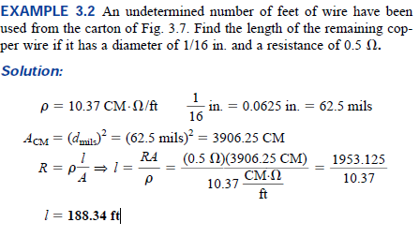
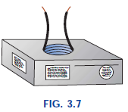
3.2 Example 3.2
Abu Ahmed Ferdaus, CSE, DU.

Slide 16
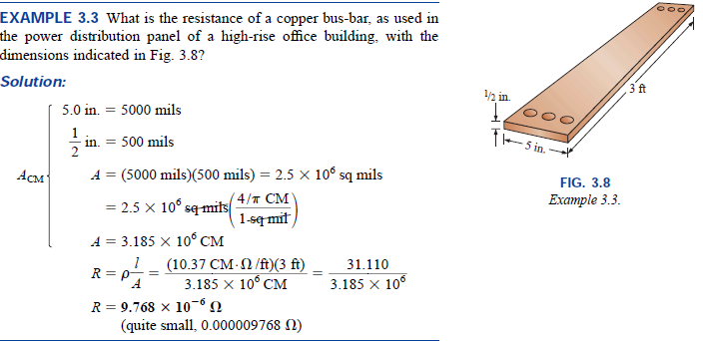
3.2 Example 3.3
Abu Ahmed Ferdaus, CSE, DU.

Slide 17
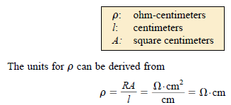
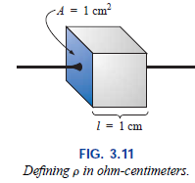
3.4 Resistance: Metric Unit
In SI units, the resistivity would be measured in ohm-meters, the area in square meters, and the length in meters. However, the meter is generally too large a unit of measure for most applications, and so the centimeter is usually employed. The resulting dimensions for Eq. (3.1) are therefore
Abu Ahmed Ferdaus, CSE, DU.

Slide 18
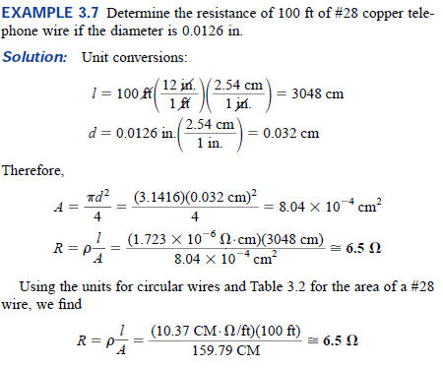
3.4 Example 3.7
Abu Ahmed Ferdaus, CSE, DU.

Slide 19
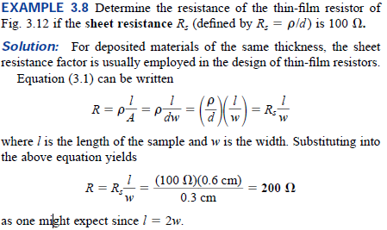
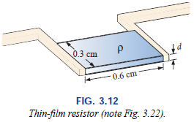
3.4 Example 3.8
Abu Ahmed Ferdaus, CSE, DU.

Slide 20
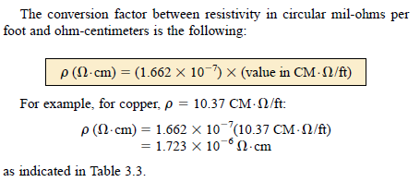
3.4 Conversion of resistivity
Abu Ahmed Ferdaus, CSE, DU.

Slide 21
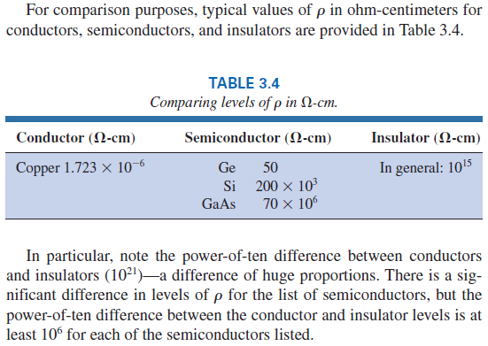
3.4 Comparison of ρ
Abu Ahmed Ferdaus, CSE, DU.

Slide 22
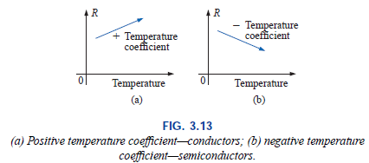
3.5 Temperature Effects
Temperature has a significant effect on the resistance of conductors, semiconductors, and insulators.
Conductor: for good conductors, an increase in temperature will result in an increase in the resistance level. Consequently, conductors have a positive temperature coefficient.
Abu Ahmed Ferdaus, CSE, DU.

Slide 23
3.5 Temperature Effects
Reason: Conductors have a generous number of free electrons, and any introduction of thermal energy will have little impact on the total number of free carriers.
In fact, the thermal energy only increases the intensity of the random motion of the particles within the material and makes it increasingly difficult for a general drift of electrons in any one direction to be established.
Semiconductor: for semiconductor materials, an increase in temperature will result in a decrease in the resistance level. Consequently, semiconductors have negative temperature coefficients.
Abu Ahmed Ferdaus, CSE, DU.

Slide 24
3.5 Temperature Effects
Reason: In semiconductors, an increase in temperature imparts a measure of thermal energy to the system that results in an increase in the number of free carriers in the material for conduction.
Insulator: As with semiconductors, an increase in temperature will result in a decrease in the resistance of an insulator. The result is a negative temperature coefficient.
Superconductor: superconductors are conductors of electric charge that, for all practical purposes, have zero resistance.
Abu Ahmed Ferdaus, CSE, DU.

Slide 25
3.7 Types of Resistors
Resistors are made in many forms, but all belong in either of two groups: fixed or variable. The most common of the low-wattage, fixed-type resistors is the molded carbon composition resistor.
For a particular style and manufacturer, the size of a resistor increases with the power or wattage rating.
Increasing in size for increased wattage ratings is due to withstand (resist) the higher currents and dissipation losses.
The size of a resistor does not define its resistance level.
Resistors of this type are readily available in values ranging from 2.7 Ω to 22 MΩ.
Abu Ahmed Ferdaus, CSE, DU.

Slide 26
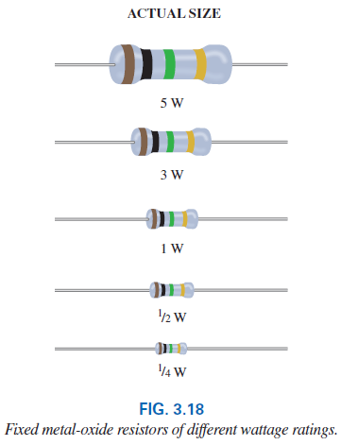
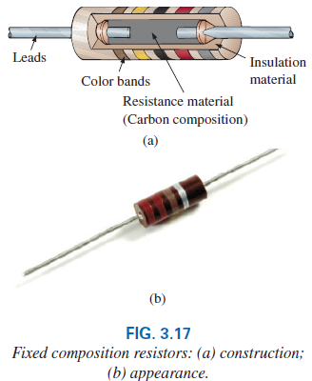
3.7 Fixed Resistors
Abu Ahmed Ferdaus, CSE, DU.

Slide 27
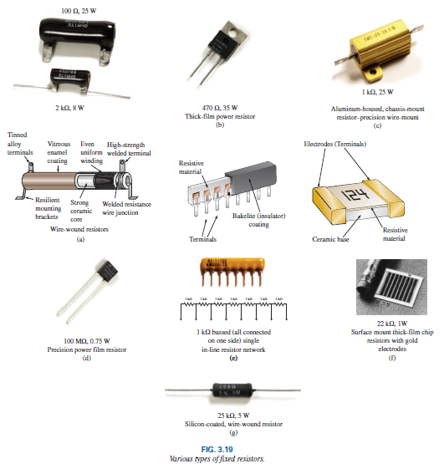
3.7Fixed Resistors
Abu Ahmed Ferdaus, CSE, DU.

Slide 28
3.7 Variable Resistors
Variable resistors, as the name implies, have a terminal resistance that can be varied by turning a dial, knob, screw, or whatever seems appropriate for the application.
They can have two or three terminals, but most have three terminals. If the two- or three-terminal device is used as a variable resistor, it is usually referred to as a rheostat.
If the three terminal device is used for controlling potential levels, it is then commonly called a potentiometer.
Even though a three-terminal device can be used as a rheostat or potentiometer (depending on how it is connected), it is typically called a potentiometer.
Abu Ahmed Ferdaus, CSE, DU.

Slide 29
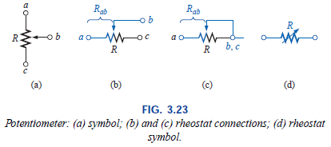
3.7 Variable Resistors
Abu Ahmed Ferdaus, CSE, DU.

Slide 30
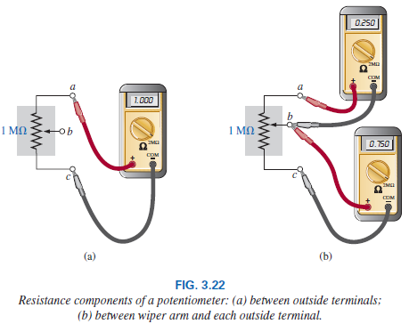
3.7 Variable Resistors
Most potentiometers have three terminals in the relative positions. The knob, dial, or screw in the center of the housing controls the motion of a contact that can move along the resistive element connected between the outer two terminals.
Abu Ahmed Ferdaus, CSE, DU.

Slide 31
3.7 Variable Resistors
The resistance between the outside terminals a and c in Fig. 3.22(a) is always fixed at the full rated value of the potentiometer, regardless of the position of the wiper arm b.
The resistance between the wiper arm and either outside terminal can be varied from a minimum of 0 Ω to a maximum value equal to the full rated value of the potentiometer.
The sum of the resistances between the wiper arm and each outside terminal equals the full rated resistance of the potentiometer.
Abu Ahmed Ferdaus, CSE, DU.

Slide 32
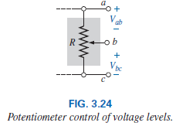
3.7 Variable Resistors
When the device is used as a potentiometer, the connections are as shown in Fig. 3.24. It can be used to control the level of V_{ab,} V_{bc}, or both, depending on the application.
Abu Ahmed Ferdaus, CSE, DU.

Slide 33
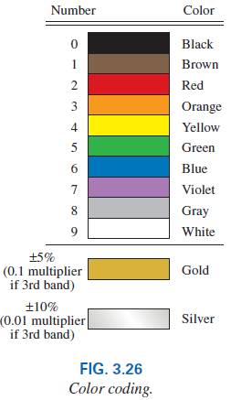
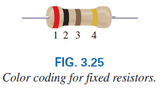
3.8 Color Coding and Standard Resistor Values
A wide variety of resistors, fixed or variable, are large enough to have their resistance in ohms printed on the casing. Some, however, are too small to have numbers printed on them, so a system of color coding is used.
For the thin-film resistor, four, five, or six bands may be used.
Abu Ahmed Ferdaus, CSE, DU.

Slide 34
3.8 The Four-band Scheme
For the four-band scheme, the bands are always read from the end that has a band closest to it. The bands are numbered as shown as follows:
The first and second bands represent the first and second digits, respectively. (They are the actual first two numbers that define the numerical value of the resistor.)
The third band determines the power-of-ten multiplier for the first two digits (actually the number of zeros that follow the second digit for resistors greater than 10 ).
The fourth band is the manufacturer’s tolerance, which is an indication of the precision by which the resistor was made.
Abu Ahmed Ferdaus, CSE, DU.

Slide 35
3.8 The Four-band Scheme
If the fourth band is omitted, the tolerance is assumed to be 20%.
The fourth band will be either 5% or 10% as defined by gold and silver, respectively.
Remembering which color goes with each digit takes a bit of practice. In general, the colors start with the very dark shades and move toward the lighter shades.
Abu Ahmed Ferdaus, CSE, DU.

Slide 36
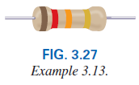
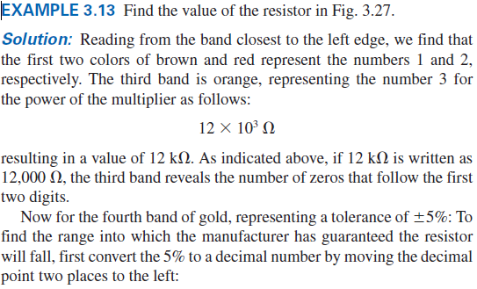
3.8 The Four-band Scheme
Abu Ahmed Ferdaus, CSE, DU.

Slide 37
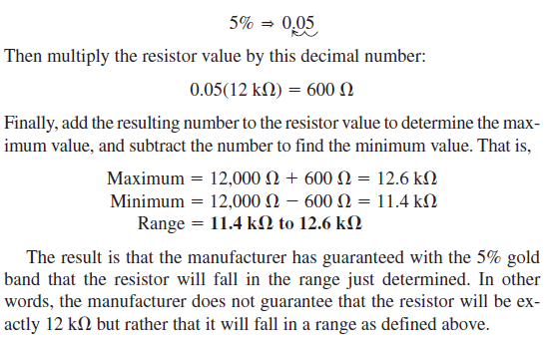
3.8 The Four-band Scheme
Abu Ahmed Ferdaus, CSE, DU.

Slide 38
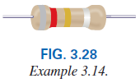
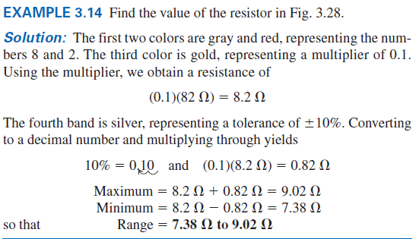
3.8 The Four-band Scheme
Abu Ahmed Ferdaus, CSE, DU.

Slide 39
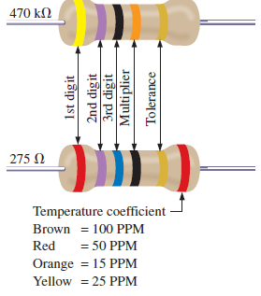
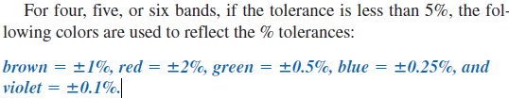
3.8 The Five-band Scheme
Some manufacturers prefer to use a five-band color code. In such cases, three digits are provided before the multiplier.
The fifth band remains the tolerance indicator. If the manufacturer decides to include the temperature coefficient, a sixth band will appear with the color indicating the PPM (parts per million) level.
Abu Ahmed Ferdaus, CSE, DU.

Slide 40
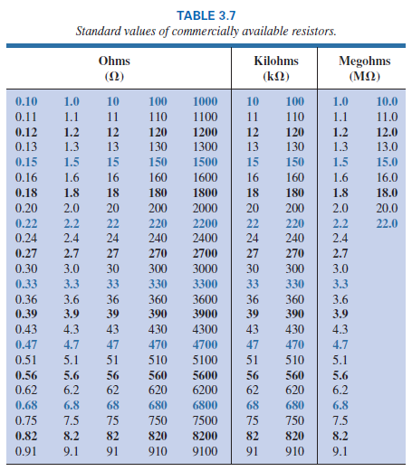
3.8 Standard Resistor Values
The values in boldface blue are available with 5%,10%, and 20% tolerances, making them the most common of the commercial variety.
The values in boldface black are typically available with 5% and 10% tolerances, and
Those in normal print are available only in the 5% variety.
Abu Ahmed Ferdaus, CSE, DU.

Slide 41


3.9 Conductance
By finding the reciprocal of the resistance of a material, we have a measure of how well the material will conduct electricity. The quantity is called conductance, has the symbol G, and is measured in siemens (S):
A resistance of 1 MΩ is equivalent to a conductance of 10⁻⁶ S, and a resistance of 10 Ω is equivalent to a conductance of 10⁻¹ S.
The larger the conductance, therefore, the less the resistance and the greater the conductivity.
Abu Ahmed Ferdaus, CSE, DU.

Slide 42
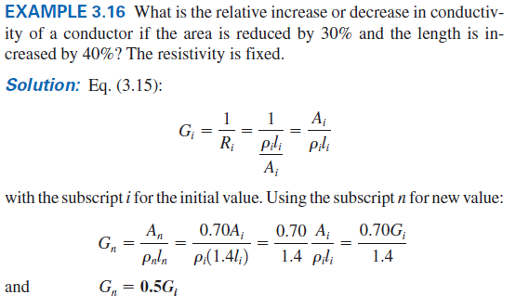
3.9 Example 3.16
Abu Ahmed Ferdaus, CSE, DU.

Slide 43
3.10 Ohmmeter
The ohmmeter is an instrument used to perform the following tasks and several other useful functions:
1. Measure the resistance of individual or combined elements
2. Detect open-circuit (high-resistance) and short-circuit (low-resistance) situations
3. Check continuity of network connections and identify wires of a multilead cable
4. Test some semiconductor (electronic) devices
Never hook up an ohmmeter to a live circuit!
Never store a VOM or a DMM in the resistance mode.
Abu Ahmed Ferdaus, CSE, DU.

Slide 44
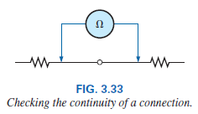
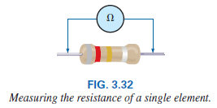
3.10 Ohmmeter
In general, however, the resistance of a resistor can be measured by simply connecting the two leads of the meter across the resistor, as shown in Fig. 3.32.
There is no need to be concerned about which lead goes on which end; the result is the same in either case since resistors offer the same resistance to the flow of charge (current) in either direction.
When measuring the resistance of a single resistor, it is
Abu Ahmed Ferdaus, CSE, DU.

Slide 45
3.10 Ohmmeter
usually best to remove the resistor from the network before making the measurement.
If this is difficult or impossible, at least one end of the resistor must not be connected to the network, or the reading may include the effects of the other elements of the system.
If the two leads of the meter are touching in the ohmmeter mode, the resulting resistance is zero.
A connection can be checked as shown in Fig. 3.33 by simply hooking up the meter to either side of the connection. If the resistance is zero, the connection is secure. If it is other than zero, the connection could be weak; if it is infinite, there is no connection at all.
Abu Ahmed Ferdaus, CSE, DU.

Slide 46
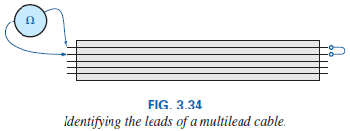
3.10 Ohmmeter
If one wire of a harness is known, a second can be found as shown in Fig. 3.34. Simply connect the end of the known lead to the end of any other lead.
When the ohmmeter indicates zero ohms (or very low resistance), the second lead has been identified.
The above procedure can also be used to determine the first known lead by simply connecting the meter to any wire at one end and then touching all the leads at the other end until a zero ohm indication is obtained.
Preliminary measurements of the condition of some electronic devices such as the diode and the transistor can be made using the ohmmeter. The meter can also be used to identify the terminals of such devices.
Abu Ahmed Ferdaus, CSE, DU.

Slide 47
3.10 Ohmmeter
Important notes about the use of any ohmmeter:
Never hook up an ohmmeter to a live circuit!
The reading will be meaningless, and you may damage the instrument. The ohmmeter section of any meter is designed to pass a small sensing current through the resistance to be measured. A large external current damage the movement and would certainly throw off the calibration of the instrument.
Never store a VOM or a DMM in the resistance mode.
If the two leads of the meter touch, the small sensing current could drain the internal battery.
VOMs should be stored with the selector switch on the highest voltage range, and the selector switch of DMMs should be in the off position.
Abu Ahmed Ferdaus, CSE, DU.

Slide 48
3.11 Other Devices
The thermistor is a two-terminal semiconductor device whose resistance, as the name suggests, is temperature sensitive. The decrease in resistance with an increase in temperature indicates a negative temperature coefficient.
The photoconductive cell is a two-terminal semiconductor device whose terminal resistance is determined by the intensity of the incident light on its exposed surface.
Varistors are voltage-dependent, nonlinear resistors used to suppress high-voltage transients; that is, their characteristics are such as to limit the voltage that can appear across the terminals of a sensitive device or system.
Abu Ahmed Ferdaus, CSE, DU.

Slide 49
Thank You
Abu Ahmed Ferdaus, CSE, DU.

